Slide 1

LOINC
https://loinc.org/slideshows/loinc-for-beginners-december-2017/

Slide 2

Serum sodium
A sodium blood test is a routine test that allows your doctor to see how much sodium is in your blood. It’s also called a serum sodium test. Sodium is an essential mineral to your body. It’s also referred to as Na+.
Sodium is particularly important for nerve and muscle function. Your body keeps sodium in balance through a variety of mechanisms. Sodium gets into your blood through food and drink. It leaves the blood through urine, stool, and sweat. Having the right amount of sodium is important for your health. Too much sodium can raise your blood pressure.

Slide 3
Serum sodium
In EHR, different hospitals or clinics might use different naming conventions:
C1231
SNA
Sodium Test
Na+ blood test
It is a huge barrier for sharing data across departments, clinics and hospitals

Slide 4
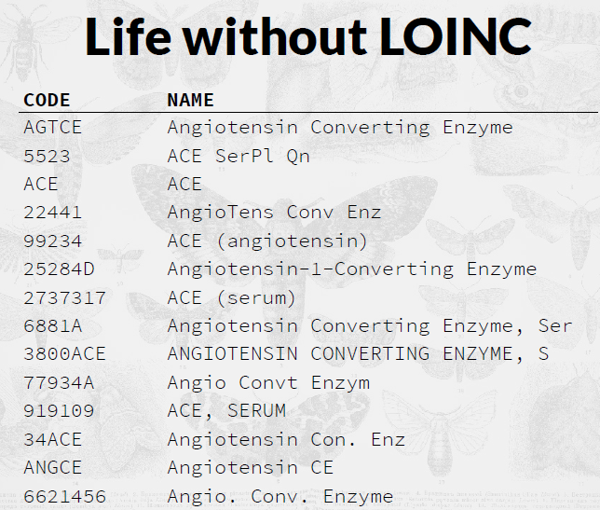
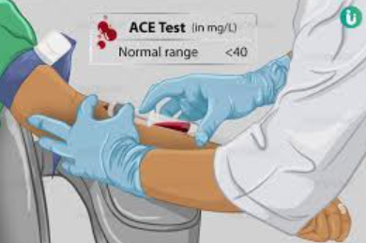
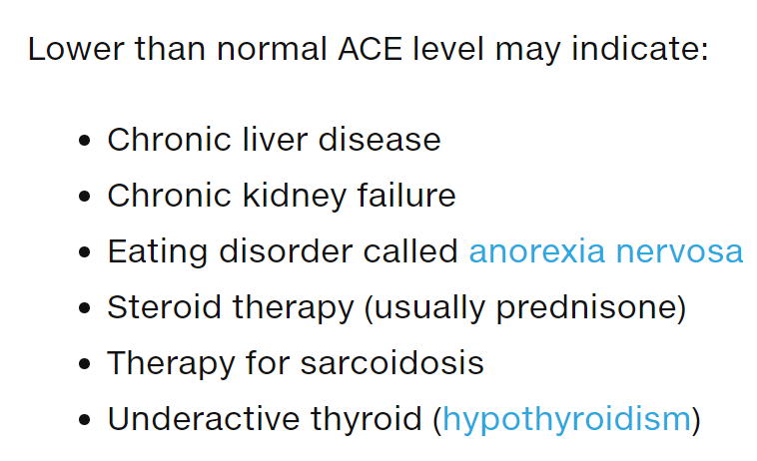
https://www.mountsinai.org/health-library/tests/ace-blood-test

Slide 5
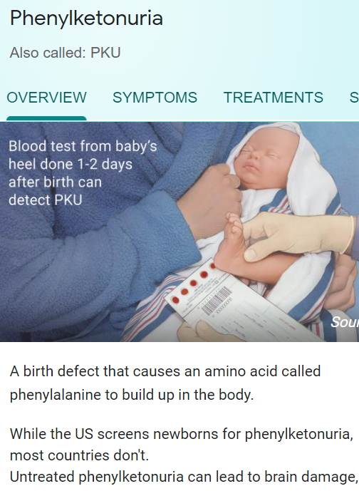
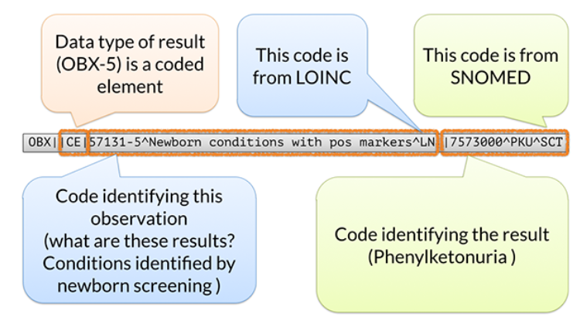
LOINC (Logical Observation Identifiers Names and Codes)
The international standard for identifying health measurements, observations, and documents.
LOINC is the global lingua franca for identifying tests and observations.
a LOINC code identifies the question and a SNOMED CT code represents the answer

Slide 6
LOINC
LOINC provides a set of universal names and ID codes for identifying laboratory and clinical test results. LOINC facilitates the exchange and pooling of results, such as blood hemoglobin, serum potassium, or vital signs, for clinical care, outcomes management, and research.
Started in 1994 at Regenstrief, Indiana
Originally, LOINC provides a code system for the observation identifier field (OBX-3) of the HL7 observation reporting message

Slide 7
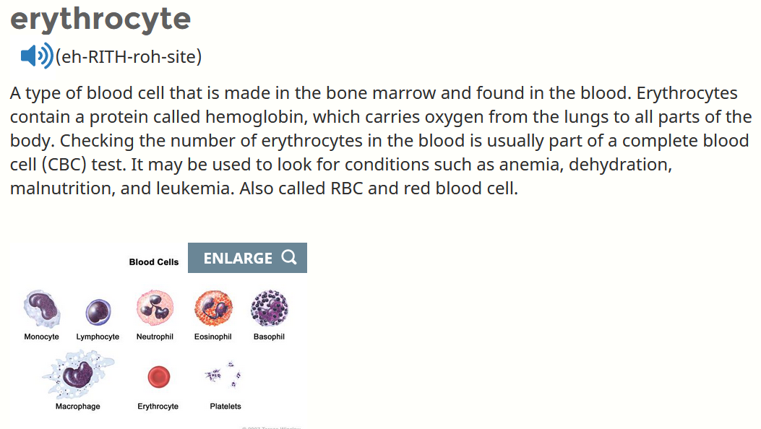
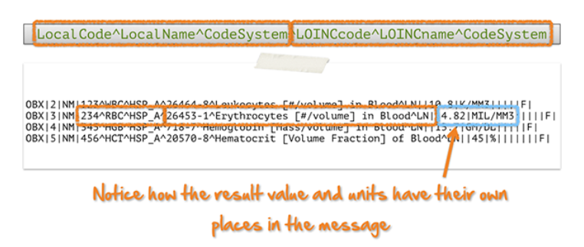
Sending local test codes and names along with LOINC codes
The OBX-3 slot allows 2 sets of triplets, one for your local concept and one for the concept from the vocabulary standard LONIC code.

Slide 8
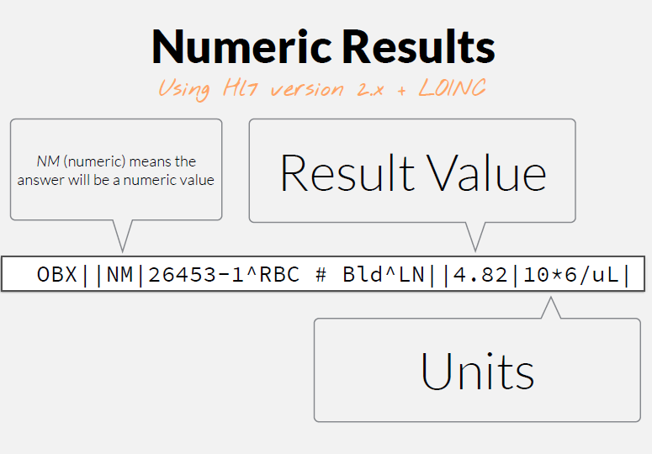

Slide 9
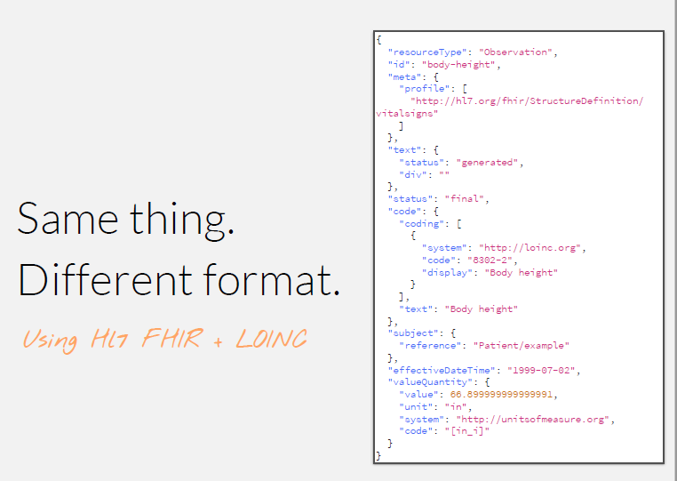


Slide 10
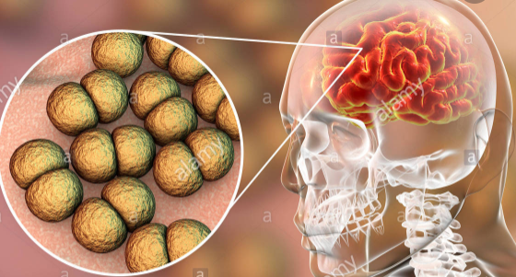
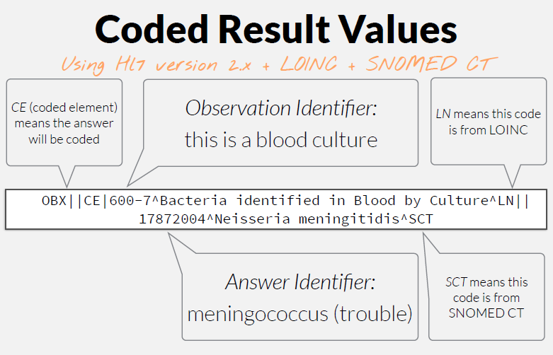

Slide 11
LOINC Term
A LOINC term is defined as the combination of the LOINC code and the Fully Specified Name (FSN).
The LOINC code is a unique, permanent identifier
The FSN is composed of five or six main Parts
All names are case insensitive.

Slide 12
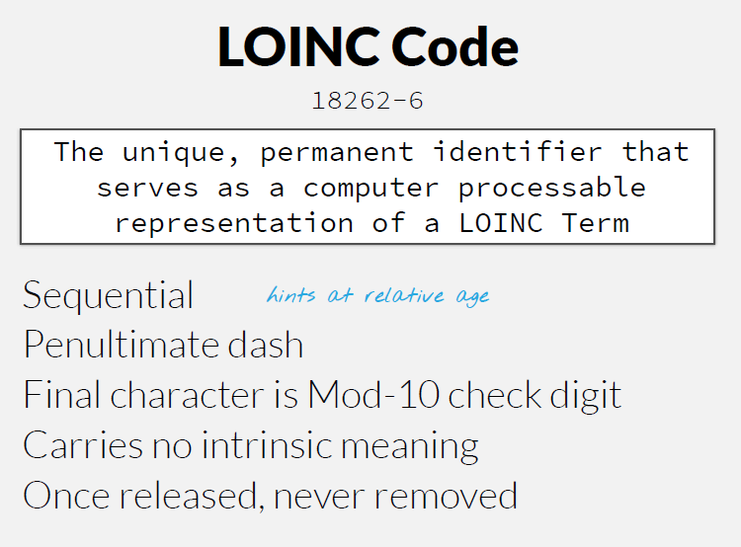
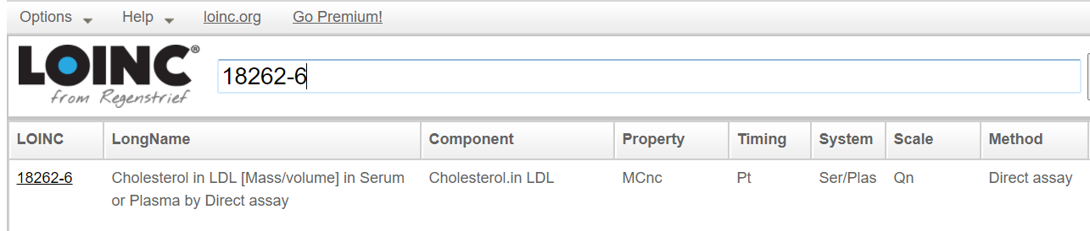
https://search.loinc.org/searchLOINC/search.zul

Slide 13
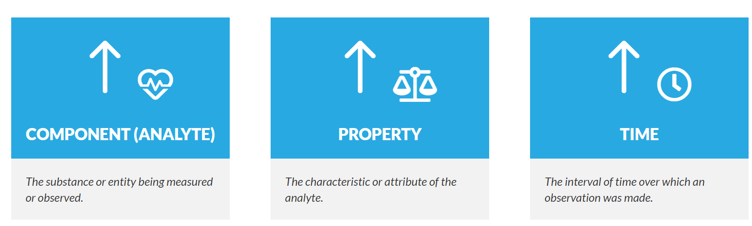
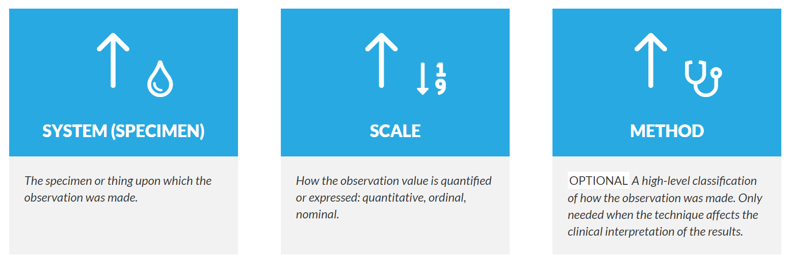
LOINC Code
LOINC's goal is to create different codes for each test, measurement, or observation that has a clinically different meaning. To do that LOINC codes distinguish a given observation (test ordered/reported, survey question, clinical document) across six dimensions that we call Parts.

Slide 14
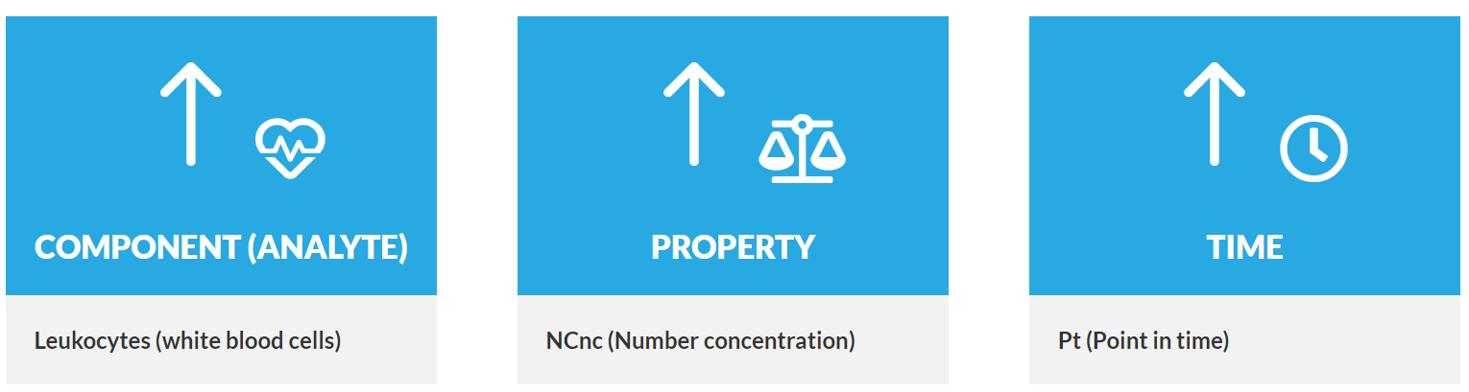
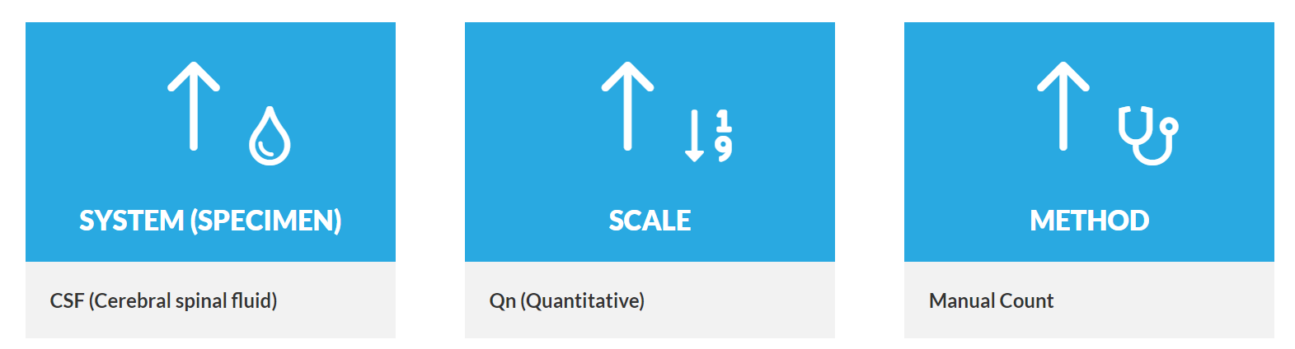
LONIC Code example
Here is a breakdown of the LOINC for a manual count of white blood cells in cerebral spinal fluid specimen, which is represented by LOINC code 806-0:

Slide 15
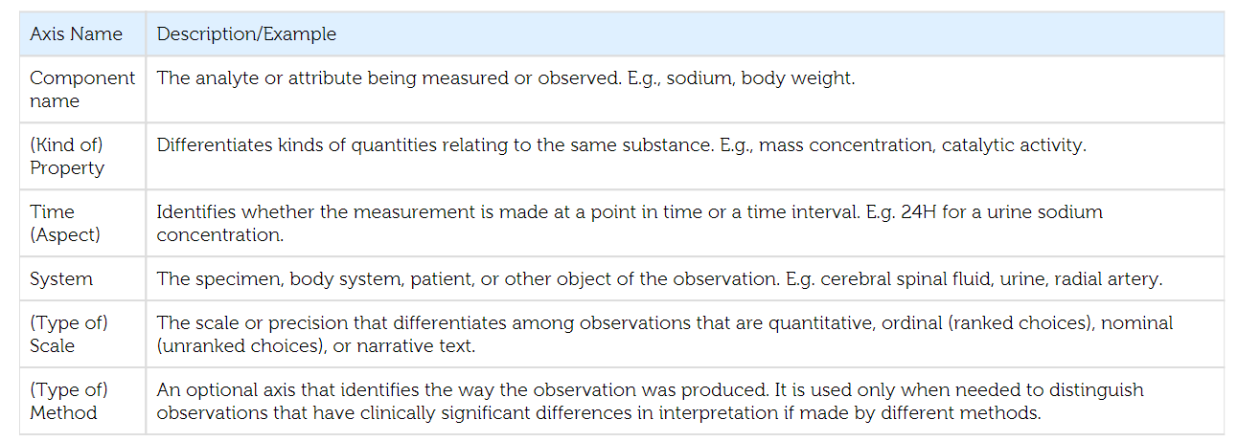

Slide 16
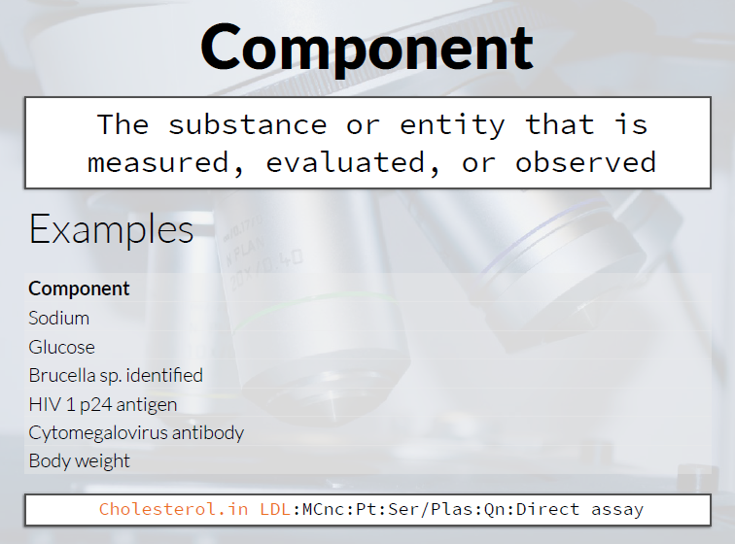

Slide 17
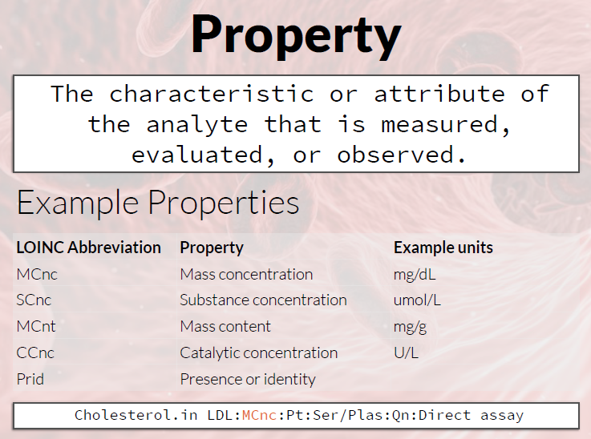

Slide 18
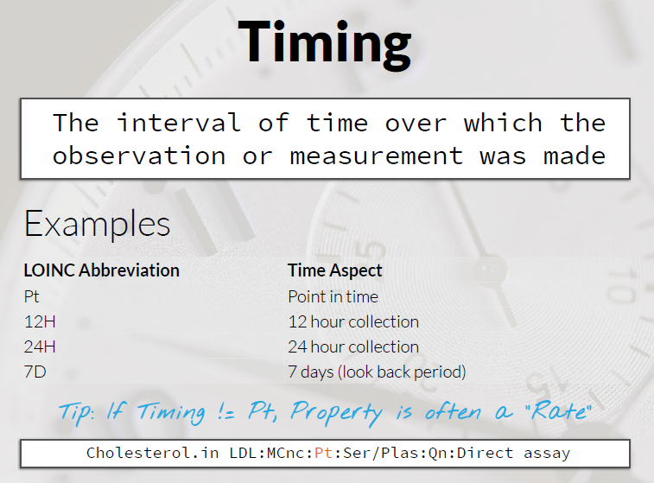

Slide 19
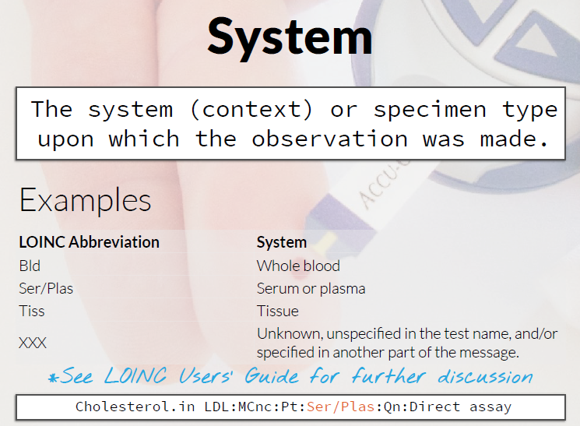

Slide 20
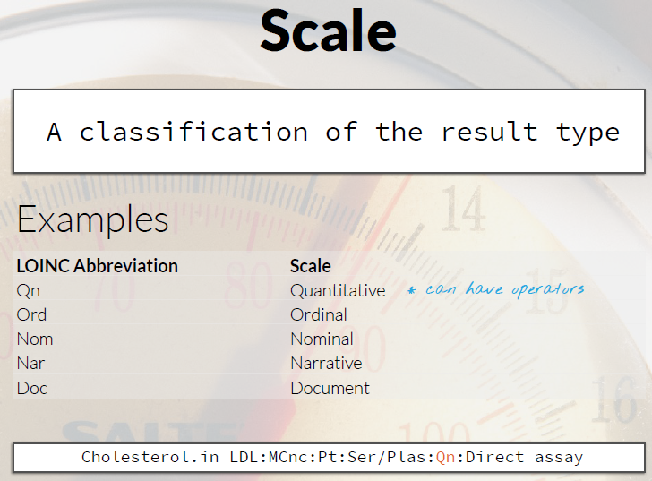
In the example previously alluded to, the presence or absence of pain would be considered nominal data, while the severity of pain represented by categories such as none, mild, moderate, or severe would be ordinal data. If pain was analyzed on a Visual Analog Scale from 0-100, where 100 would be two times as painful as 50, this would be numerical data.

Slide 21
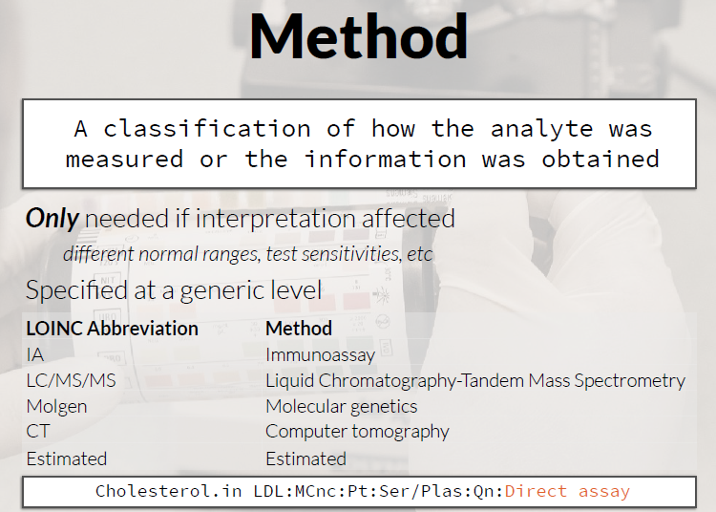

Slide 22
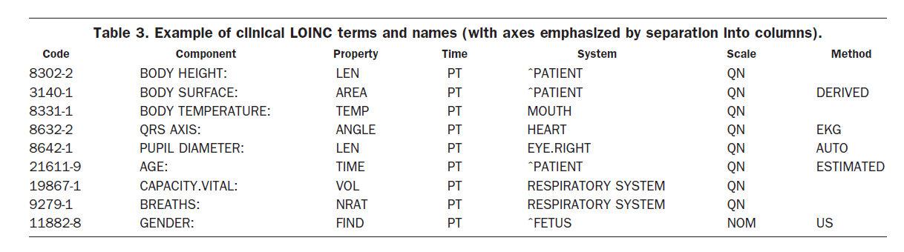

Slide 23
LOINC Names
LOINC creates several different text labels (names) to represent each concept. We call the six-part formal name, as described above, the Fully-Specified Name (FSN). We also create a more clinician-friendly display called the Long Common Name (LCN) and a Short Name that can be handy when you need a column header in a report. Here are the names for LOINC code 806-0:

Slide 24
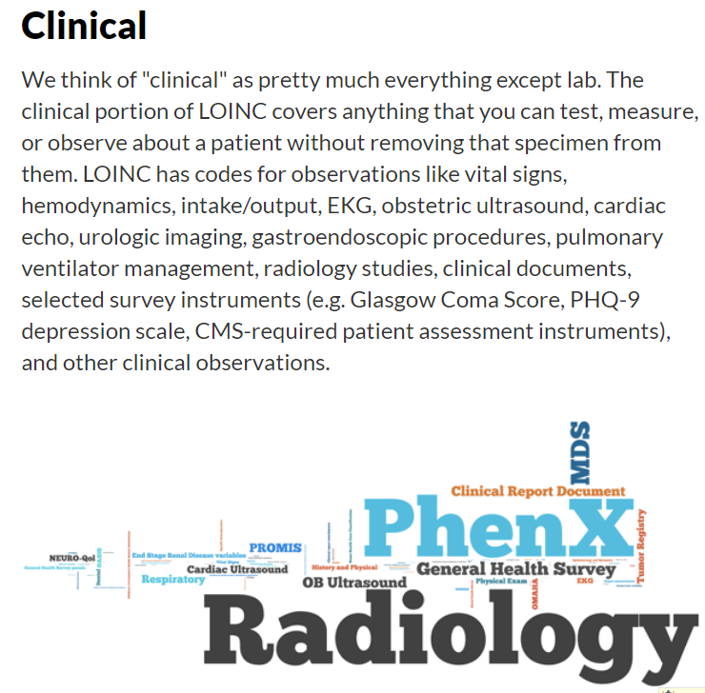
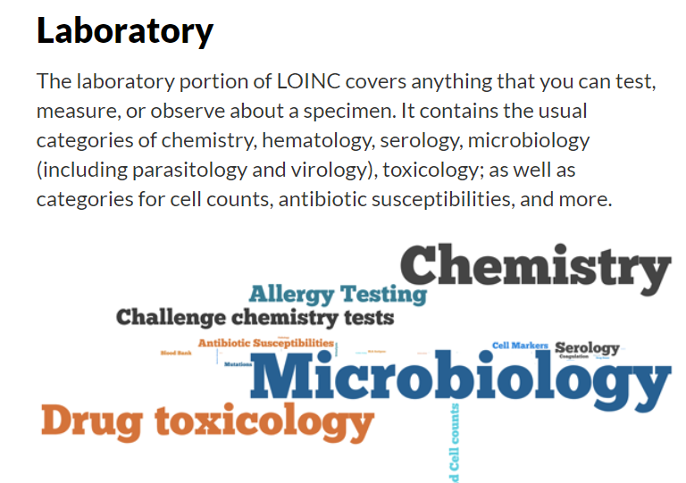
Scope of LOINC

Slide 25
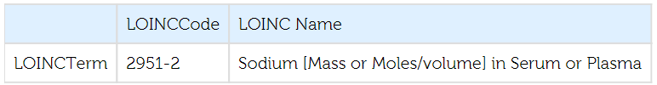
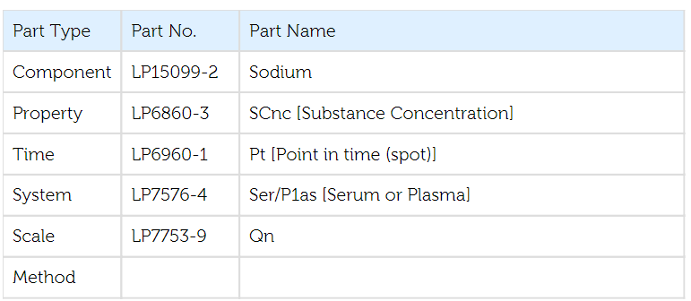

Slide 26
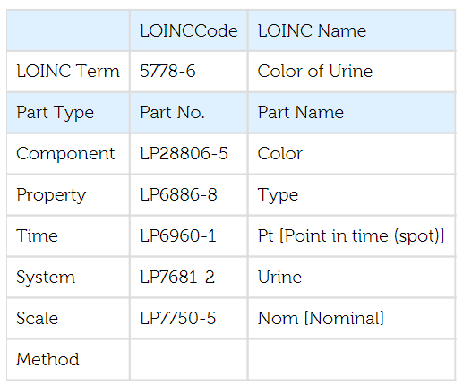

Slide 27
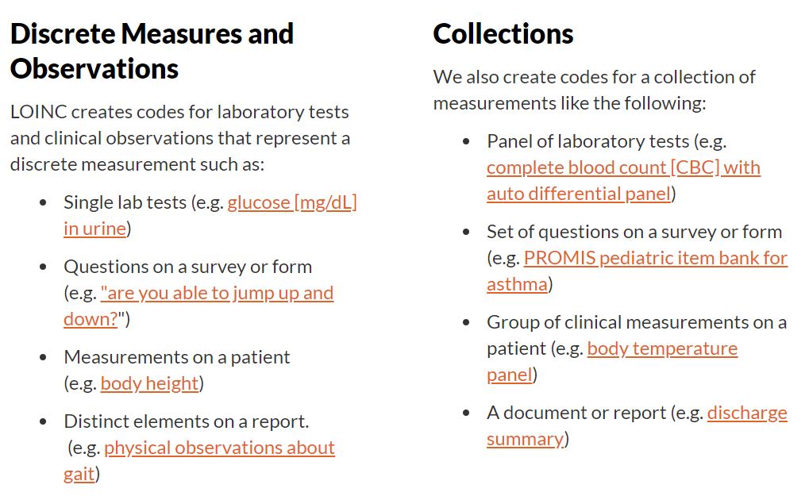
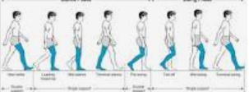

Slide 28
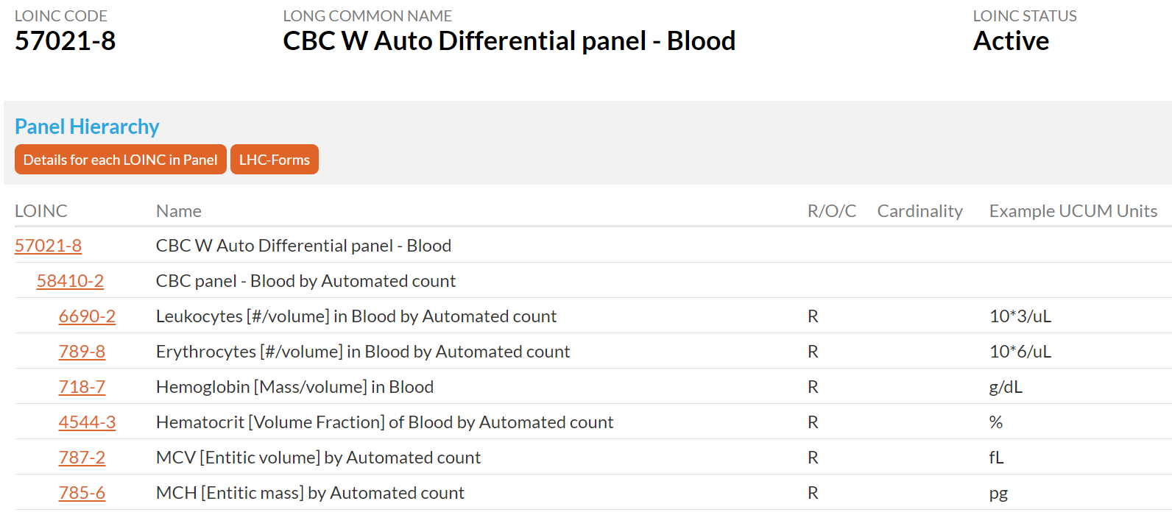
LOINC Panel Hierarchy
https://loinc.org/57021-8/

Slide 29
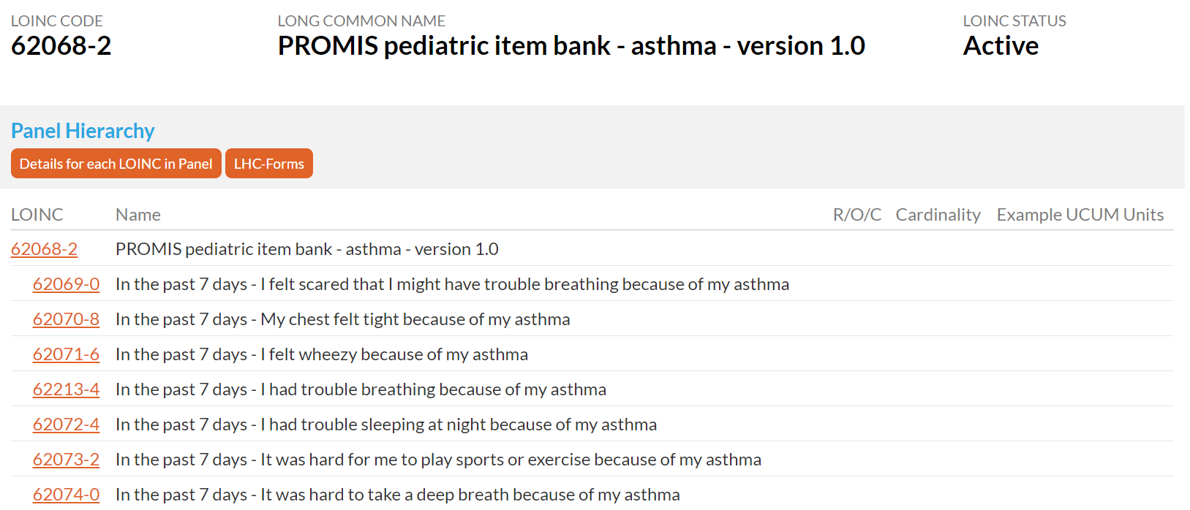
https://loinc.org/62068-2/

Slide 30
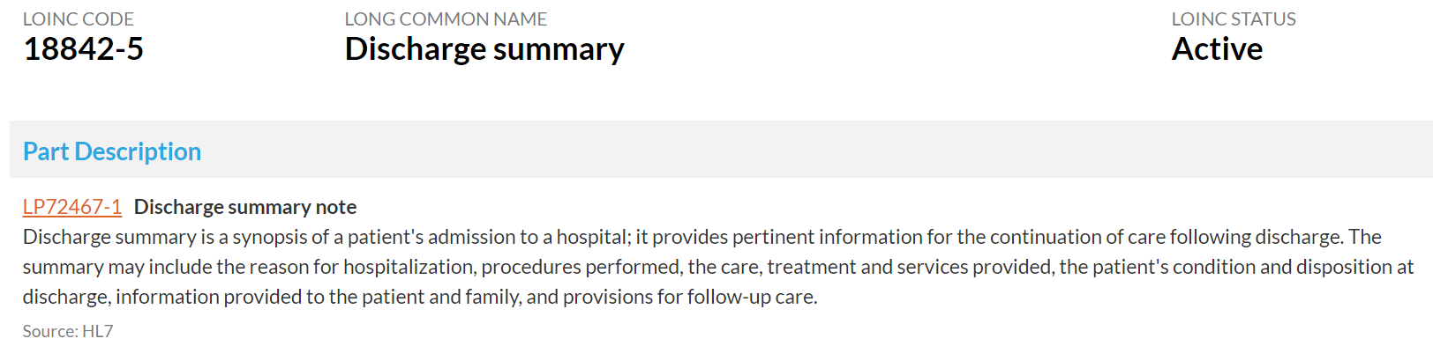
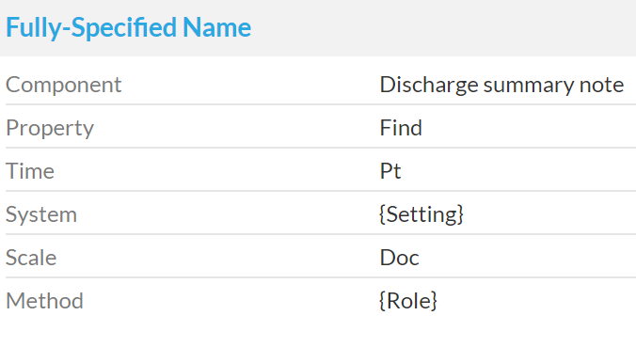
https://loinc.org/18842-5/

Slide 31
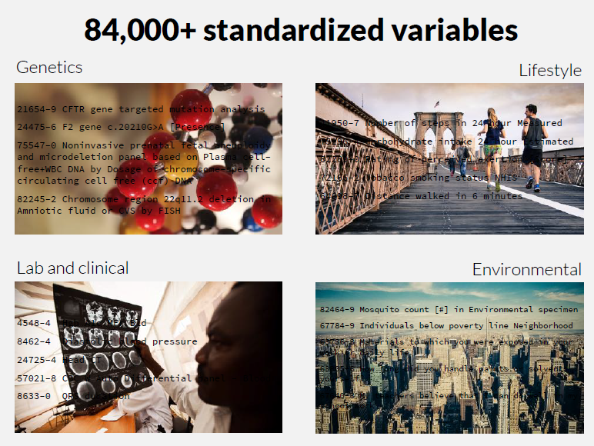

Slide 32
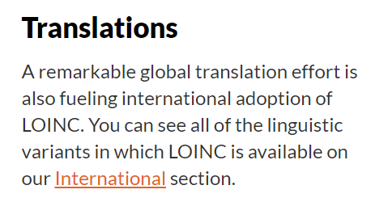
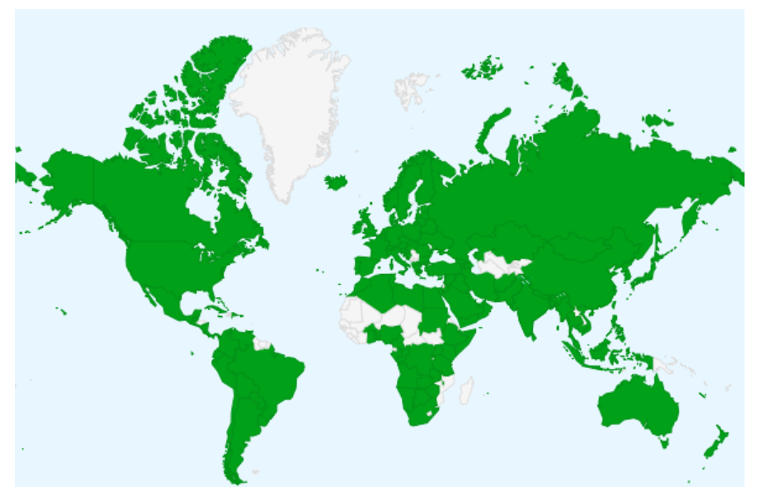
Global Adoption
163 countries

Slide 33
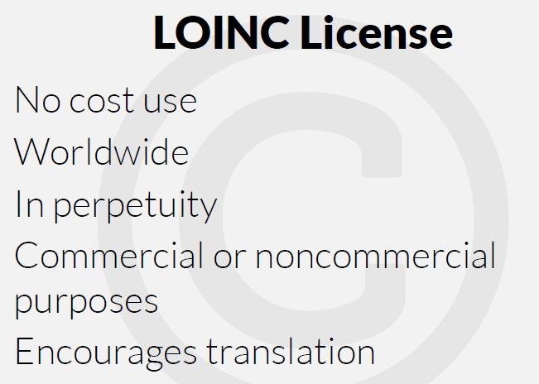

Slide 34
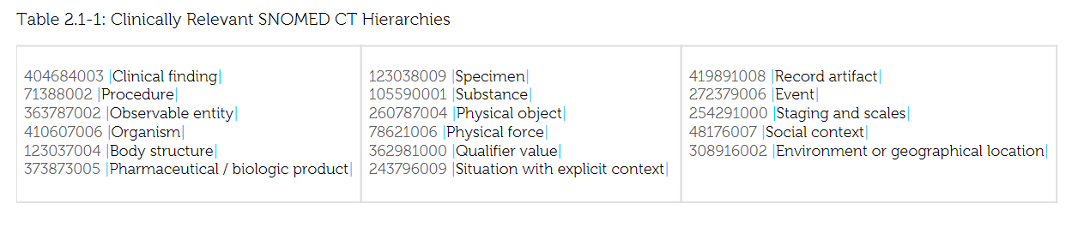
LOINC and Snomed CT

Slide 35
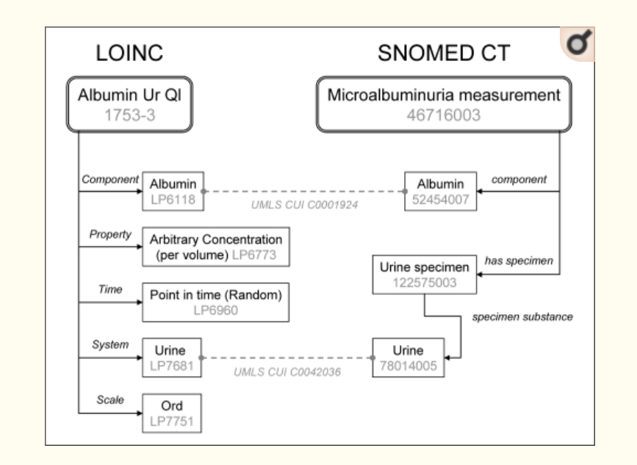
LOINC and SNOMED CT
A urine microalbumin test is a test to detect very small levels of a blood protein (albumin) in your urine. A microalbumin test is used to detect early signs of kidney damage in people who are at risk of developing kidney disease.

Slide 36
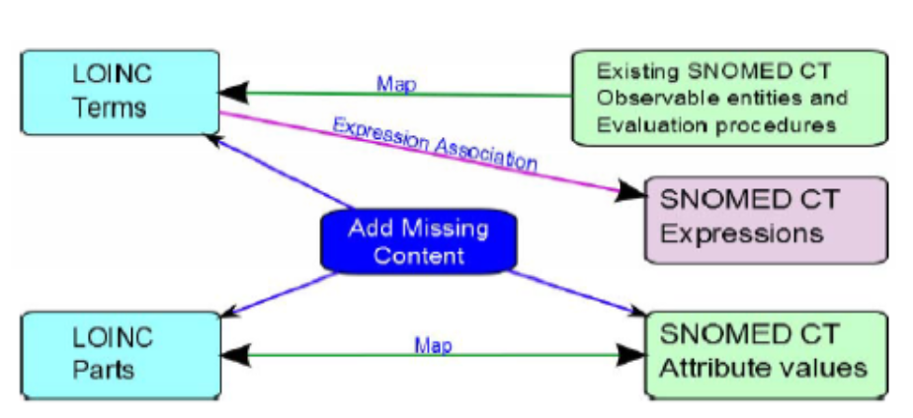
LOINC and SNOMED CT

Slide 37
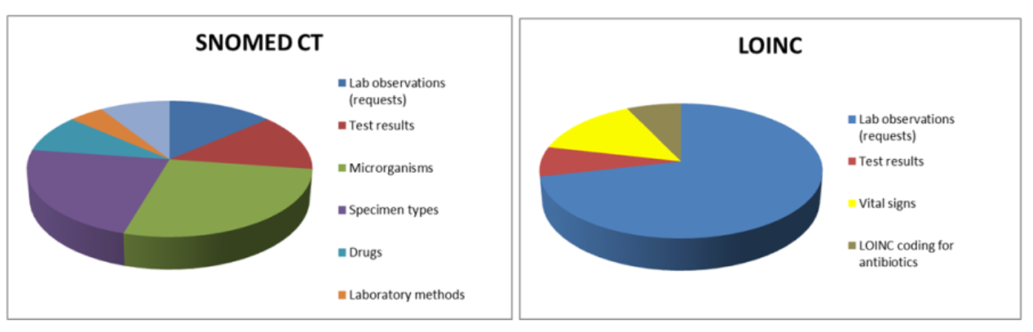

Slide 38
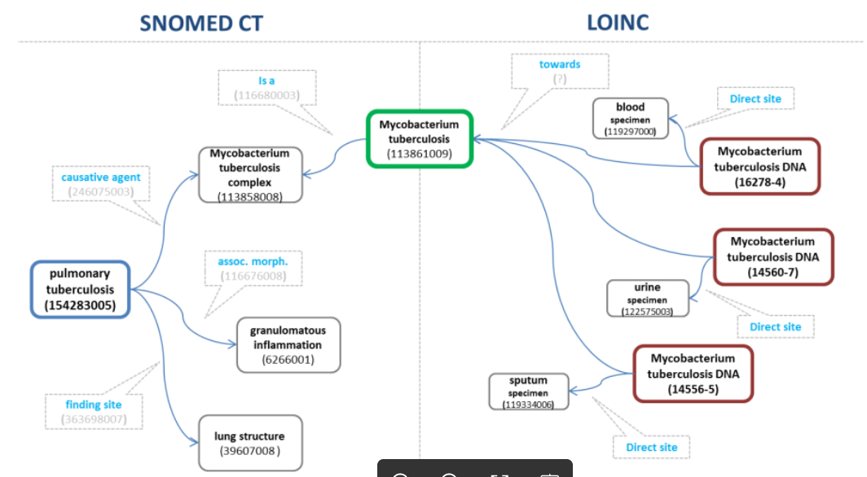
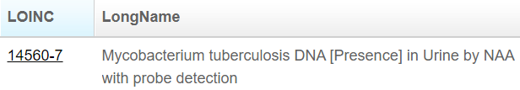
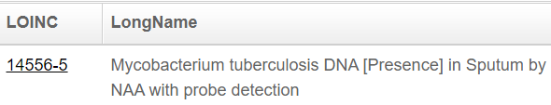
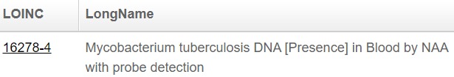

Slide 39
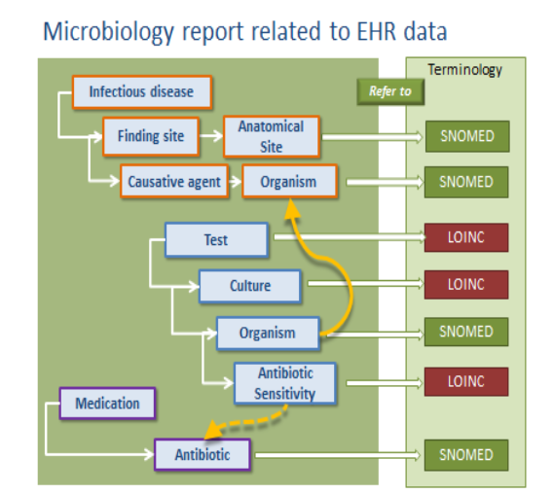

Slide 40
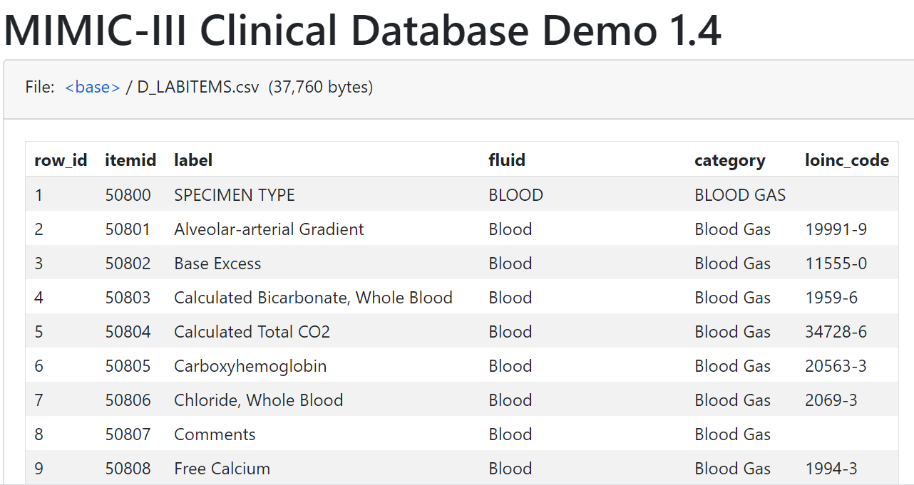
MIMIC III LOINC

Slide 41


SQL on labitems table
SELECT *
FROM d_labitems
SELECT COUNT(itemid), loinc_code
FROM d_labitems
GROUP BY loinc_code;
SELECT COUNT(itemid), loinc_code
FROM d_labitems
GROUP BY loinc_code
ORDER BY COUNT(itemid) DESC;
SELECT COUNT(itemid), category
FROM d_labitems
GROUP BY category;

Slide 42
RxNorm
https://www.nlm.nih.gov/bsd/disted/video/clin_info/rxnorm.html

Slide 43

Betsy Lehman
In 1994, Betsy Lehman, a reporter of Boston Globe and mother of two young girls, was battling advanced stage of breast cancer. She was killed by the four times the intended dose of a powerful chemotherapy drug at Dana-Farber Hospital (the world premier cancer center). – Betsy Lehman Center
https://betsylehmancenterma.gov/

Slide 44


The Problem: The US Lacks a Centralized Health Care Data System

Slide 45





The Problem: The US Lacks a Centralized Health Care Data System
Joe has a bad cough with a lot of mucous
https://www.goodrx.com/obredon/what-is
OBREDON 2.5mg-200mg/5mL Solution; (9487)
HYDROCODONE BITARTRATE 2.5 mg in 5 mL / GUAIFENESIN 200 mg in 5 mL ORAL SOLUTION [OBREDON]; (6069433)

Slide 46
The Solution: RxNorm Standardized Drug Terminology
interoperability
HYDROCODONE BITARTRATE 2.5 mg in 5 mL / GUAIFENESIN 200 mg in 5 mL ORAL SOLUTION [OBREDON] (6069433)
OBREDON 2.5mg-200mg/5mL Solution (9487)
RxNorm Standardized Name and Code
Name: Guaifenesin 40 MG/ML / Hydrocodone Bitartrate 0.5 MG/ML Oral Solution [Obredon] Code: 1598284
OBREDON 2.5mg-200mg/5mL Solution (9487)
HYDROCODONE BITARTRATE 2.5 mg in 5 mL / GUAIFENESIN 200 mg in 5 mL ORAL SOLUTION [OBREDON] (6069433)

Slide 47
What is RxNorm?
Standardized naming system to codify clinical drugs.
National standard for coding clinical drugs in the U.S.
Tool for supporting semantic interoperation between different systems.
Humans
Computers
Health Care: Drug Information

Slide 48

RxNorm in the Health Ecosystem
MTHSPL: HYDROCODONE BITARTRATE 2.5 mg in 5 mL / GUAIFENESIN 200 mg in 5 mL ORAL SOLUTION [OBREDON]
RxNorm:
Guaifenesin 40 MG/ML / Hydrocodone Bitartrate 0.5 MG/ML Oral Solution [Obredon]
RXCUI 1598284
GS: OBREDON 2.5mg-200mg/5mL Solution
MMSL: Obredon, 200 mg-2.5 mg/5 mL oral liquid

Slide 49
RxNorm Use Cases
e-Prescribing
Clinical Research
Aggregate and analyze prescription datasets
Research Data Management
Data management plans to make data FAIR:
Findable
Accessible
Interoperable
Reusable

Slide 50
RxNorm in Clinical Research
RxNorm allows population-based studies of prescription drugs.
Joe is taking an opioid.
Researchers want to know about the prescribing patterns in Joe’s county.
Prescription medications already coded with RxNorm can yield faster results.

Slide 51

RxNorm in Research Data Management
TEDDY Study
The Environmental Determinants of Diabetes in the Young
Epidemiologic study exploring genetic and environmental factors related to childhood diabetes in children (from birth to age 15) by collecting medication data.
Researchers decided to use RxNorm to code medications when developing the Research Data Management plan.

Slide 52
RxNorm
RxNorm is two things:
a normalized naming system for generic and branded drugs; and
a tool for supporting semantic interoperation between drug terminologies and pharmacy knowledge base systems.
The National Library of Medicine (NLM) produces RxNorm.

Slide 53
RxNorm
RxNorm contains the names of prescription and many over-the-counter drugs available in the United States.
RxNorm includes generic and branded:
Clinical drugs - pharmaceutical products given to (or taken by) a patient with therapeutic intent
Drug packs - packs that contain multiple drugs, or drugs designed to be administered in a specified sequence

Slide 54

https://pubmed.ncbi.nlm.nih.gov/30157516/

Slide 55
How to build RxNorm
1. Group source data into collections of synonyms (called concepts).
Sample source data:
Naproxen Tab 250 MG
Naproxen 250mg tablet (product)
NAPROXEN@250 mg@ORAL@TABLET
Naproxen 250 MILLIGRAM In 1 TABLET ORAL TABLET
NAPROXEN 250MG TAB,UD [VA Product]
Sources format their drug names in many different ways. Although the drug names in this Naproxen example appear different, they all have the same meaning at a certain level of abstraction. RxNorm groups these as synonyms into one concept.

Slide 56

How to build RxNorm
2. Create an RxNorm normalized name for each concept (if the concept is in-scope and unambiguous).
About 60% of the drug names from RxNorm source vocabularies receive RxNorm normalized names. RxNorm normalized names and codes are available in SAB=RXNORM which is one of the source vocabularies within the full RxNorm data set.
The other 40% of source vocabulary drug names do not receive RxNorm normalized names because they are either out-of-scope or their names are too ambiguous including medical devices, foods, and enzymes.
The Naproxen concept above is in-scope for RxNorm, so it is assigned an RxNorm normalized name. The normalized name consists of the ingredient, strength, and dose form (in that order) for fully-specified generic drugs.
In our example, the RxNorm normalized name is 'Naproxen 250 MG Oral Tablet'. The branded version of this drug uses the same format but includes the brand name in brackets at the end (e.g., 'Naproxen 250 MG Oral Tablet [Prosaid]').

Slide 57
How to build RxNorm
3. Assign an RxNorm concept unique identifier (RXCUI) to each concept and an RxNorm atom unique identifier (RXAUI) to each atom.
RXCUI
Every name and code provided to NLM by a source vocabulary receives an RXCUI.
An RXCUI is a machine-readable code or identifier that points to the common meaning shared by the various source names grouped and assigned to a particular concept.
RXAUI
Concepts are collections of synonyms at a given level of abstraction. Each drug name carries additional characteristics, including its source, its code (the unique identifier assigned by its source), and its term type (described below). An atom is a drug name plus these additional characteristics. Each atom within a concept receives an atom unique identifier, an RXAUI.

Slide 58
How to build RxNorm
4. Include relationships and attributes from the source data.
Source data include more than drug names in some cases. Data can also include relationships that link drug names to other drug names and ingredients, as well as other information, such as National Drug Codes (NDCs), marketing categories, and pill imprint information.

Slide 59
How to build RxNorm
5. Create related RxNorm names and relationships.
In addition to the fully complete clinical drug names (ingredient, strength, and dose form), RxNorm also creates names at other levels of specificity:
ingredient / precise ingredient / multiple ingredients
ingredient + strength
ingredient + dose form / ingredient + dose form group

Slide 60


Slide 61


Sample Drug Names from Data Sources
ranitidine 15 mg/mL oral syrup
RANITIDINE HCL 15 mg/mL ORAL SYRUP
RANITIDINE HCL 15 mg/mL ORAL SYRUP
RANITIDINE HCL@15 mg/mL@ORAL@SYRUP
Ranitidine HCl Syrup 15 MG/ML (75 MG/5ML)
Ranitidine Hydrochloride 15 MG/ML Oral Solution
Ranitidine Hydrochloride 15mg/1mL Oral solution
Ranitidine 15 MG/ML Oral Solution
RANITIDINE 15 MG ORAL SYRUP
RANITIDINE HYDROCHLORIDE 15 MG ORAL SYRUP
RANITIDINE HYDROCHLORIDE 16.8 MG ORAL SYRUP
RANITIDINE HYDROCHLORIDE 75 MG ORAL SOLUTION
RANITIDINE HYDROCHLORIDE 15 mg in 1 mL ORAL SYRUP
RANITIDINE HYDROCHLORIDE 15 MG ORAL SYRUP
Ranitidine 15 mg in 1 mL ORAL SOLUTION
RANITIDINE 15 MG ORAL SOLUTION
RANITIDINE HYDROCHLORIDE 16.8 MG ORAL SOLUTION
RxNorm Normalized Name: Ranitidine 15 MG/ML Oral Solution
RxNorm Concept Unique Identifier (RXCUI) = 705610

Slide 62
Accessing RxNorm Data
RxNorm Files Download page (UMLS License might be required).
RxNorm-related Application Programming Interfaces (APIs)
allows web-based access using pre-installed queries
RxNorm web-based browser (RxNav): https://rxnav.nlm.nih.gov/

Slide 63


Slide 64


MIMIC III Prescriptions Table
SELECT drug_type, drug, drug_name_poe, ndc
FROM prescriptions
WHERE drug LIKE '%citrate%' AND ndc NOT LIKE 'None';
SELECT drug_type, drug, drug_name_poe, ndc
FROM prescriptions
WHERE drug LIKE '%citrate%';

Slide 65
References
LOINC User’s Guide: https://loinc.org/kb/users-guide/introduction/
LOINC for beginners: https://loinc.org/slideshows/loinc-for-beginners-december-2017/
LOINC annual report: https://loinc.org/files/reports/2019%20LOINC%20Annual%20Report.pdf
LOINC search: https://search.loinc.org/searchLOINC/search.zul

Slide 66
RxNorm Resources
RxNorm Home Page: https://www.nlm.nih.gov/research/umls/rxnorm/index.html
RxNav and API Landing Page:
https://rxnav.nlm.nih.gov/
RxNorm Download Files Page: https://www.nlm.nih.gov/research/umls/rxnorm/docs/rxnormfiles.html

